Slide 1
Designing Appropriate Alliance Governance Modes
Farok J. Contractor
Rutgers University
farok@andromeda.rutgers.edu
ESNIE: Cargese, Corsica, May 2015

Slide 2
Cooperation is Humanity’s Collective Past and Future
Specialization along the Value Chain is at least 35,000 years old
Specialization necessarily requires coordination, rules, mutual forbearance and cooperation to capture joint economic benefit
“The Firm”: Specialized and coordinated activities under a hierarchy
Interfirm Cooperation or “Alliances” were not so prominent until the 1990s
Most examples were under government mandates in emerging nations
Today alliances are an inescapable part of corporate organization
Because even the biggest firms do not have the internal knowledge (or efficiency) to handle complex products and services

Slide 3
Alliances: Strategy Role and Negotiations
DEFINITION OF “ALLIANCE”
”Any cooperative arrangement involving two or more separate firms, between the extremes of spot contracts and complete merger.”
-- Farok Contractor
Two or more firms joined in common purpose while remaining independent
-- Yoshino and Rangan

Slide 4
Alliances: Strategy Role and Negotiations
TYPES OF ALLIANCES
Co-Marketing [e.g., Burgers + Movies]
Coordination Agreements [e.g., Airline Code Sharing]
[e.g., Regus – TripIt or Regus – Virgin Atlantic]
Agreement on Technical Standards [e.g., Telecommunication Standards]
Joint R&D [e.g., Nokia -- Microsoft]
Joint Exploration [e.g., Oil Field Exploration Risk Sharing]
Real Options Agreements [e.g., Pharmaceutical – BioTech Startup]
Technology Licensing (including knowhow and IP)
Franchising
Supply Chain Alliances or Cooperative Outsourcing
Joint Venture Company

Slide 5
The Role of Alliances in Business
Alliances are integral to the practice of management today and constitute a significant portion of business activity
According to Kale, Singh and Bell (2009) 80% of Fortune 1000 CEOs state that alliances constitute 26% of their company revenues in 2007-2008.
According to a survey of some of the world’s largest firms, in Ernst (2004), 20% of Assets and over 30% of R&D is in alliances – as opposed to in-house work
Companies like IBM or Novartis state in their annual reports that they interact with +100,000 partners worldwide.
Notes:
Abbot-CAT in early stage (fixed payments) + Production Stage (Royalty)
Cross-Shareholding With Call and Put Options: GSK - Theravance

Slide 6
Alliances: Strategy Role and Negotiations
Notes:
Abbot-CAT in early stage (fixed payments) + Production Stage (Royalty)
Cross-Shareholding With Call and Put Options: GSK - Theravance

Slide 7
Choosing an Appropriate Modality
Alliance Complexity and Contract Length
“Structuring and Governing Alliances: New Directions for Research,” Global Strategy Journal, (2014) Contractor, Farok J. & Reuer, Jeffrey, J., 4: 241 – 256.
Notes:
Abbot-CAT in early stage (fixed payments) + Production Stage (Royalty)
Cross-Shareholding With Call and Put Options: GSK - Theravance

Slide 8
Choosing an Appropriate Modality
Variables That Affect Governance Complexity
*
Notes:
Abbot-CAT in early stage (fixed payments) + Production Stage (Royalty)
Cross-Shareholding With Call and Put Options: GSK - Theravance

Slide 9
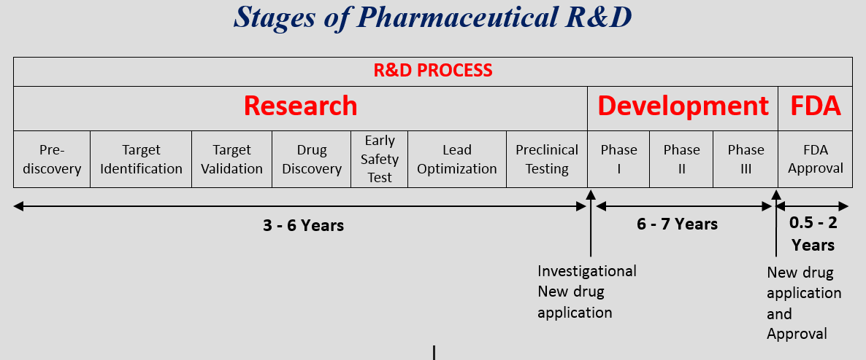
Example of a Ph.D. Dissertation by Jeongho Choi,
Rutgers University
Because there are so many explanatory variables….
NARROWER FOCUS:
Bio-Pharmaceutical Alliances U.S. SIC 2833 through 2836
Agreements with full text available
(from “Current Agreements” Database, SEC, IMS Health’s USC 5 and ReCap Databases)
Only R&D portion of value chain

Slide 10
From Jeongho Choi Dissertation, Rutgers University

Slide 11
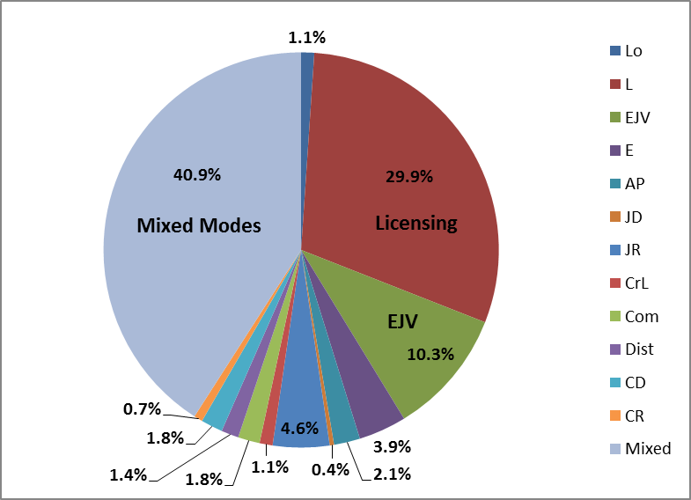
From Jeongho Choi Dissertation, Rutgers University
Incidence of Contract Provisions
Source: Recap Data: International pharmaceutical alliances.
Loan (Lo): 1.1%; Licensing (L): 29.9%; Equity Joint Venture (EJV): 10.3%;
Equity (E): 3.9%; Asset Purchasing (AP): 2.1%; Joint-Development (JD): 0.4%;
Joint Research (JR): 4.6%; Cross-Licensing (CrL): 1.1%; Commercialization (Com): 1.8%;
Distribution (Dist): 1.4%; Contract Development (CD): 1.8%;
Contract Research (CR): 0.7%; Mixed modes (Mixed): 40.9%

Slide 12
From Jeongho Choi Dissertation, Rutgers University
Notes:
Abbot-CAT in early stage (fixed payments) + Production Stage (Royalty)
Cross-Shareholding With Call and Put Options: GSK - Theravance

Slide 13
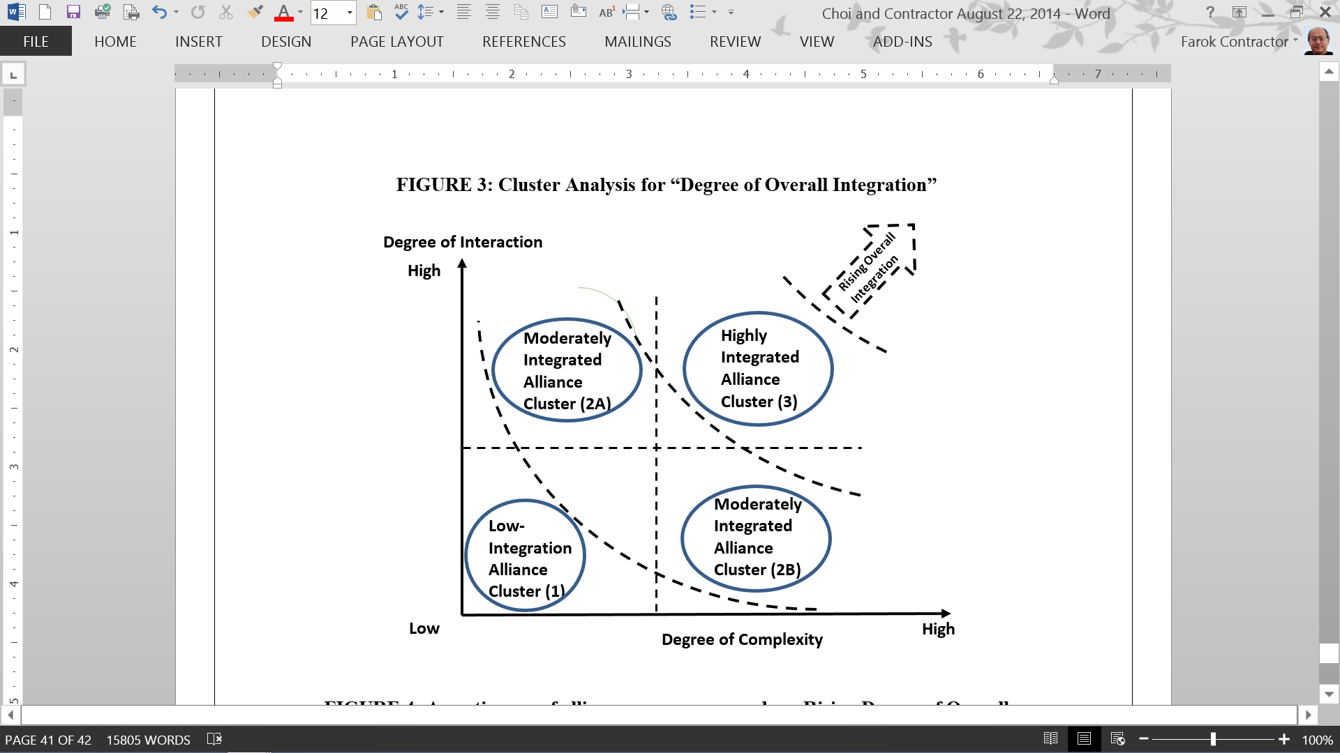
From Jeongho Choi Dissertation, Rutgers University
Notes:
Abbot-CAT in early stage (fixed payments) + Production Stage (Royalty)
Cross-Shareholding With Call and Put Options: GSK - Theravance

Slide 14
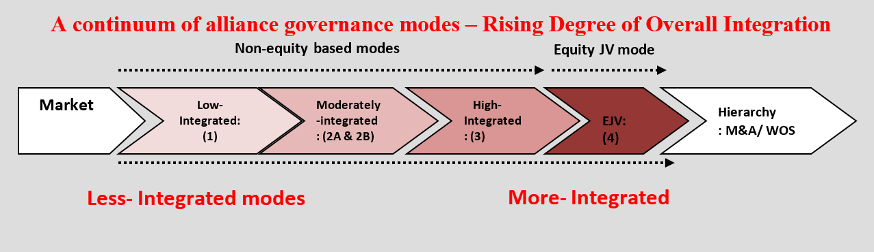
From Jeongho Choi Dissertation, Rutgers University
237 Agreements in the Bio-Pharmaceutical Sector US SIC 2833 through 2836
Notes:
Abbot-CAT in early stage (fixed payments) + Production Stage (Royalty)
Cross-Shareholding With Call and Put Options: GSK - Theravance

Slide 15
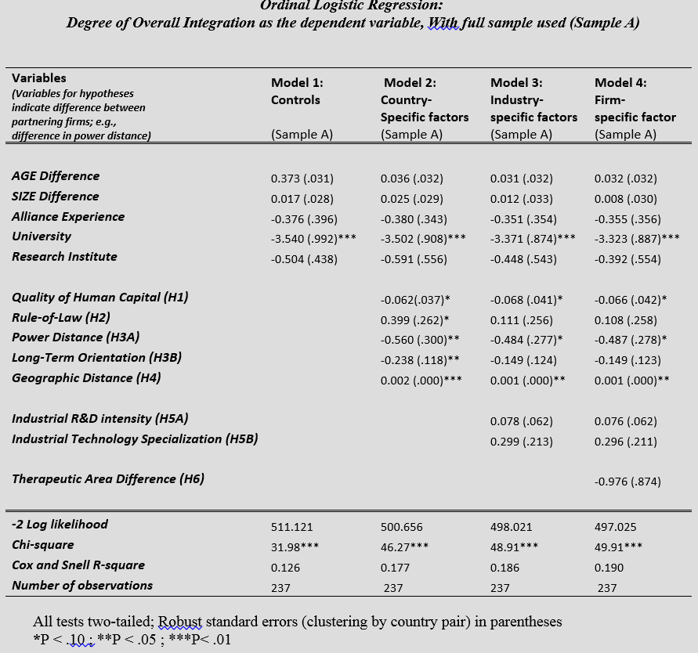
RESULTS

Slide 16
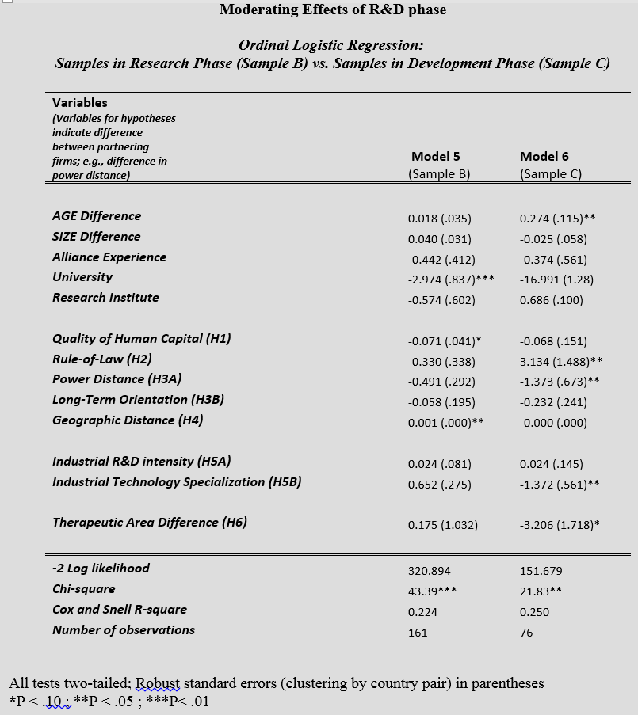
RESULTS

Slide 17
From Jeongho Choi Dissertation, Rutgers University

Slide 18
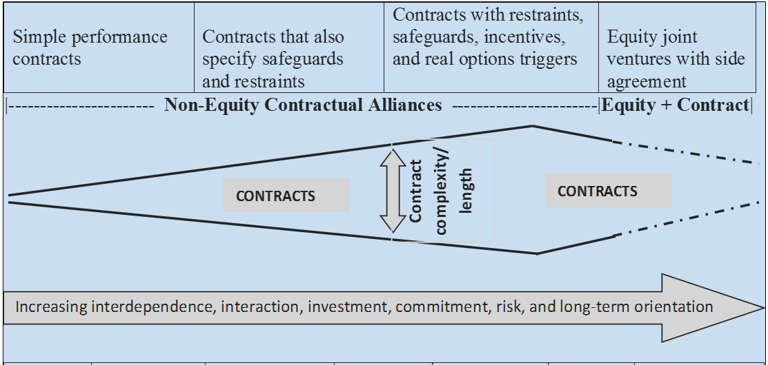
CONCLUSIONS
Alliance Design is a Function of Multiple Factors
Partner Characteristics and Differences
  Culture
  Past experience (e.g., Therapeutic area)
  Technology specialization
  Absorptive capacity
  Country Differences
    Rule of law
    IP protection
    Human capital
    Geographic distance

Slide 19
CONCLUSIONS
Alliance Design is a Function of Multiple Factors
Which Portion of Value Chain?
  Partners work on same task domain
  Partners specialize in different portions of value chain
Characteristics of Knowledge
  Complexity
  Novelty
  Tacitness
  Joint creation of new knowledge or transfer of existing?

Slide 20
And Now
A Whole Different Research Question
In Designing Alliance Agreements, the Objective is to
  Maximize Synergistic Value of the Partnership
  BUT ALSO
  Each partner Wishes to Increase Their Individual Share of the Net Benefits Created by the Alliance
What Factors Influence the Appropriation of Alliance Benefit Shares?

Slide 21


How the alliance pie is split:
Value appropriation by each partner in cross-border technology transfer alliances
Contractor, F.J. & Woodley, J. A.
Rutgers University & Ramapo College
Journal of World Business (2015)
(forthcoming)
Available On-line

Slide 22
The Research Question
Determinants of Capture of Share of Alliance Benefits
But Only Two Papers on the Latter Question
  Adegbesan & Higgins (2010) [Empirical]
  Dyer, Singh & Kale (2008) [Conceptual]
What determines how the incremental value
created by the alliance is shared by
  The local partner and
  The technology-supplying foreign partner?

Slide 23
The Research Setting
Technology Transfer Alliances
  US Manufacturing Technology
  Supplied to International Partners
  Sample of 141 agreements
Diversity of Compensation Types Earned by
Technology-Supplying Partner
  Lump-sums
  Running Royalties
  Supply Chain Profit Markups
  Dividends and Equity Growth on JV Equity
Often More Than One of the Above
Compensation Elements Bundled Together in Same Agreement
Increasing Commitment, Investment & Uncertainty/Risk for Technology Supplier

Slide 24
TWO TYPES OF ALLIANCES
Technology Supplying Partner
Technology; Components
Technology Recipient Partner
Margin on Components
Royalties
Contractual Alliance Dummy = 0
Technology Supplier
Dividends; Equity Growth; Royalty; Revenue and Profits on Components; R&D
Technology Recipient Partner
Dividends; Equity Growth; Technical Learning
Initial Equity Investment;
Technology; Personnel; Components
Initial Equity Investment;
Personnel
Joint Venture Company
Additional Side Licensing and Supply Chain Agreements
Equity Joint Venture (JV) Alliance Dummy = 1

Slide 25
Volatility of Different Alliance Compensation Elements
Types of Returns to Technology Provider
More Volatile and Less Certain Compensation Elements
Dividends and Equity Growth ( BENDIV)
Technical Improvements Made by Alliance (BENTECH)
Markups on Supply Chain Trade with Partner (BENMARK)
Increasing Volatility/Uncertainty
Increasing Control
Less Volatile Compensation Elements
Royalties (BENROY)
Lumpsum Payment (BENLUMP)
For the Technology-Supplying Partner:
Does Higher “Risk” Higher Return Higher Control Modes?

Slide 26
Elements in Alliance Agreement
Expected
Return
Equity Based Compensation Elements
Majority
Equity JV
Contractual Compensation Elements
Minority Equity
JV
Supply Chain Markups
Royalties
Degree of Compensation Uncertainty/Risk
Lumpsum Payments
Overarching Hypothesis: Negotiators Think of Risk & Return Tradeoffs
Return
Tradeoff Vector
Uncertainty/Risk

Slide 27
Dependent Variable: Share of Alliance Value Captured by Knowledge/IP Supplier
Independent Variable Categories
Technology
  Partners’ relative technological capacities
  Technology transfer and agreement execution costs
  Proportions of tacit and codified knowledge
Host Nation Mandates
  Government mandate to have a local partner
Alliance Structure
  Existence of equity share for technology provider
  Majority ownership of joint venture by technology provider
Agreement Provisions
  Number of “minimum return” provisions
  “High risk” benefit / income streams
  Territorial restrictions on alliance activities

Slide 28
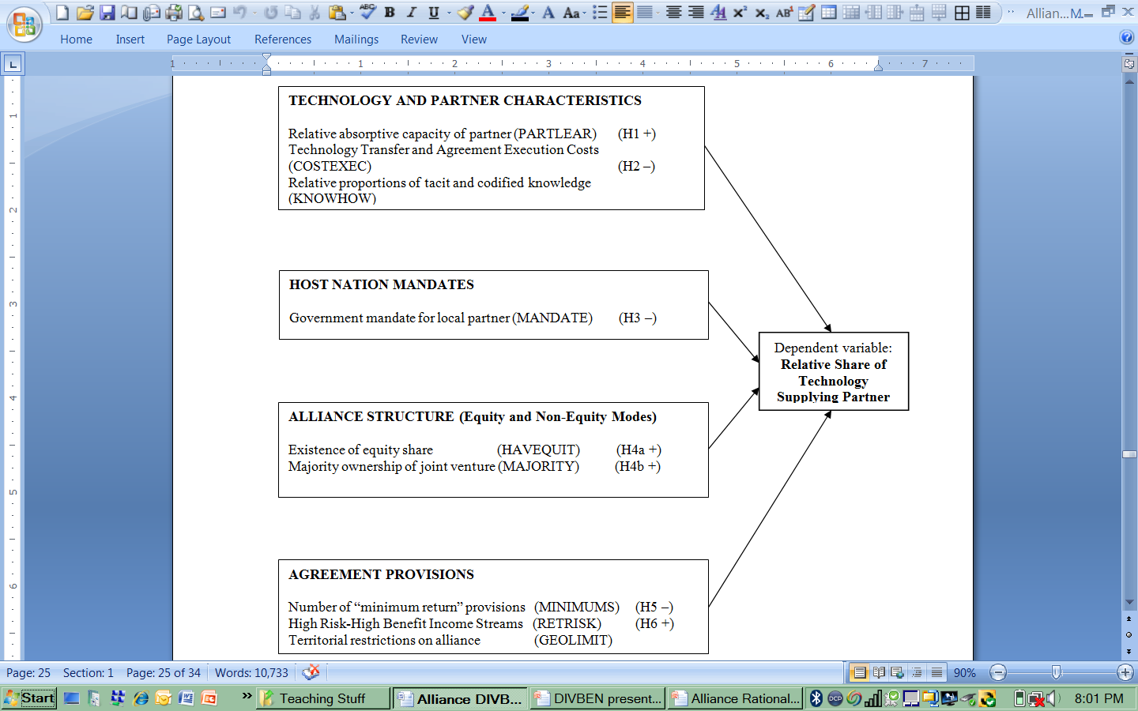
Model Summary for Share of Alliance Value Appropriated by the Technology Supplier: “DIVBEN”
- With Hypothesized Signs for Coefficients

Slide 29
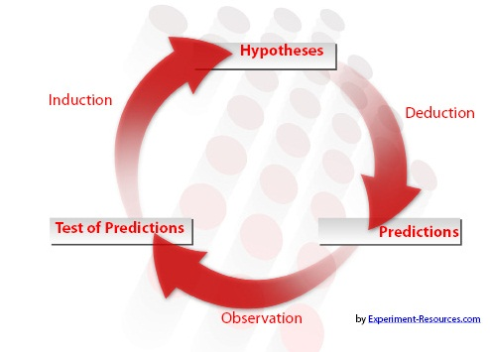
Hypotheses – Relative Technical Capacity (+)
The value of an asset such as knowledge transferred from one location (country) to another is a function of its use in the foreign market
Depends on the ability of the recipient ally to recognize, digest, assimilate, and integrate the new technology into local operations.
Adegbesan & Higgins’ (2010) study of pharma-biotech alliances, pharmaceutical partners that have superior absorptive/technical capacity realize a larger percentage of control rights and appropriation of alliance value.
The partner with the relatively stronger absorptive and learning capacity increases its bargaining power, over time (Inkpen & Beamish, 1997),
And can “…appropriate a higher percentage of the subsequent relational rents…” (Dyer, Singh & Kale, 2008, p. 140).
Hypothesis 1 (H1): The share of alliance value appropriated by the technology supplying partner is greater when the technology recipient has relatively lower technical capacity.
(Note: The expected sign of the coefficient is positive only because of the way
the variable is constructed).

Slide 30
Hypotheses
Execution Costs Borne by Tech. Supplier (-)
Some technologies are more complex and hence harder to transfer, and
Entail high resource costs for the technology supplier, Teece (1977)
Technology transfer can entail large costs borne by the technology provider in training their partner, in negotiations and other costs related to the transfer of knowledge.
The share of net alliance value appropriated by the technology supplying partner will likely be lower if they have to incur large initial and ongoing transfer costs.
Hypothesis 2 (H2): There will be a negative relationship between the technology transfer and agreement execution costs borne by the technology provider and the share of net alliance value appropriated by them.

Slide 31
Control Variable:
Relative Proportion of Tacit vs. Codified Knowledge
Corporate knowledge is typically a mix of tacit and codified expertise (Kogut & Zander, 1993).
Codified knowledge is much more observable and more easily transferable to an alliance partner than tacit knowledge.
A firm’s resources, such as proprietary knowledge or technology, influences its potential to earn economic rents (Grant, 1991)
The more so if the resources are valuable, rare, and difficult to substitute or imitate (Barney, 1991).
Dyer, Singh & Kale (2008) posit that the “…firm in an alliance/network which brings the more critical (i.e., valuable, rare, inimitable) resources to the relationship will appropriate a higher percentage of total relational rents generated from an alliance relationship” (page 140).
Proposition: One possibility is that a greater proportion of tacit or embedded knowledge enhances the bargaining power of the partner supplying technology who will capture a larger share of the overall benefits from the alliance.
Counter Argument: Intellectual property such as patents transferred to an alliance partner can sometimes be highly desirable and that therefore it is the codified portion of the technology bundle that confers on the technology supplier the greater bargaining power.

Slide 32
Hypotheses – Local Mandate (-)
Government mandates favoring a local alliance partner’s negotiation position
  Explicitly stated requirements to share technology
  Subtle insinuations that the alliance would not receive government orders unless the foreign partner released intellectual property rights to the alliance and/or trained local personnel (Murphy, 2009).
  Equity investment in certain key sectors where the government wishes to build up local technical capability – for example solar cell or wind turbine technology in China -- continues to be restricted in emerging nations (Lewis, 2007).
Mandated partnerships with national firms are likely to reduce the share of total alliance returns accruing to foreign-based technology providing firms, ceteris paribus, since the local partner has a claim on cash flows as well as a claim on managerial attention of the foreign partner.
Hypothesis 3 (H3): The presence of a government mandate that foreign firms must accept a local partner will have a negative effect on the value accruing to technology providing firms based outside such nations (compared to cases where there was no mandate).

Slide 33
Hypotheses – Equity Investment (+)
Equity vs. Contractual Alliances Such as Licensing
Two Versions of Hypothesis:
Similar to Reuer & Arino (2007) or Agdebesan & Higgins (2010), equity JV participation by the technology supplier triggers a dummy = 1 (H4a).
In a stronger version of the hypothesis, the dummy = 1 only if the technology supplier has majority equity (H4b)
Compared with contractual alliances, equity JVs
  afford the investing partner greater interaction, control and participation in the alliance.
  BUT ! Also require greater resource commitment
  Said to provide better “incentive alignment” (Oxley & Wada, 2009).

Slide 34
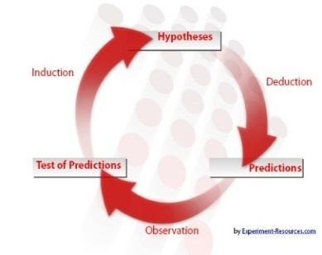

Hypotheses – Equity Investment (+)
Equity vs. Contractual Alliances Such as Licensing (continued…)
But this is by no means always the case
While equity JVs are generally (if not always) supposed to provide higher returns than a technology provider can earn through a contractual agreement,
  the volatility (i.e., risk) of JV returns is also greater cpmpared to the more steady, and more sure returns as licensor.
  JV investors can also lose money

Slide 35

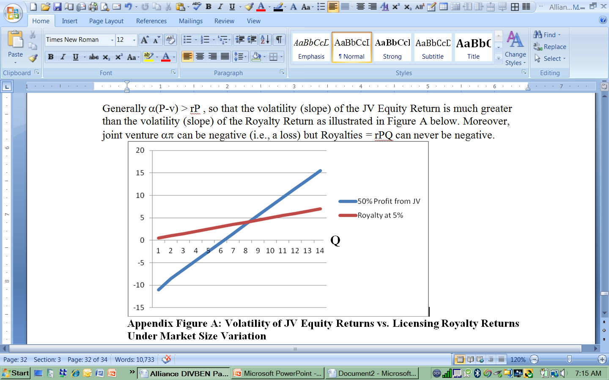
Hypotheses – Equity Investment (+)
Equity vs. Contractual Alliances Such as Licensing (continued…)
50V

Slide 36

Hypotheses – Equity Investment (+)
Equity vs. Contractual Alliances Such as Licensing (continued…)
Moreover,
  An equity investment often entails additional investment (at risk) which a mere licensor would not have to make.
  With higher risk and a larger investment – one can hypothesize that when equity investment is involved the technology supplying partner will seek to appropriate a higher share of alliance value than in the case of a contractual alliance.
Hypothesis 4a (H4a): When investing in an alliance as an equity partner, the technology providing firm will receive a larger share of value generated through the alliance, all else being equal.

Slide 37
Hypotheses – Equity Investment (+)
Equity vs. Contractual Alliances Such as Licensing (continued…)
But is the mere fact of equity participation an indicator of sufficient rent appropriation power with the technology supplying partner?
  A minority stake may wield some (but not much) influence on the decision making of the other ally. The local, technology-receiving partner may act independently even with a small equity stake held by the technology provider
  The optimum market penetration desired by an equity holder is different from that of the local partner Comparing Volatility of JV Profits and Royalties [H]
  Especially in a majority-owned JV, the personnel of the technology supplier are deputed to the alliance organization as engineers, managers and accountants, to help guide and support the technology-receiving partner – but also acting as monitors and watchdogs to constrain the opportunistic proclivities of the other partner (Das, 2005; Nooteboom, Berger, & Noorderhaven, 1997)
  It is only with a majority equity stake that an investor is more assured of being in charge. Hence a stronger form of Hypothesis 4 would state:
Hypothesis 4b (H4b): When the technology providing firm has a majority equity stake in the alliance, they will receive a larger share of value generated through the alliance, all else being equal.

Slide 38
Hypotheses
“Minimum” Provisions in Agreement (-)
Insufficient attention has been paid to the details of agreement provisions in alliance contracts (Reuer & Arino, 2007)
Equity JVs typically have an auxiliary agreement between the JV partners covering issues such as territorial limits, compensation minimums and technology sharing.
A minimum return or floor compensation (in the form of minimum sales requirements or minimum royalties) is sometimes assured to the partner supplying technology to the alliance or to the other party. (Bhattacharya & Lafontaine, 1995; Contractor, 1986).
In effect, this is partial risk-shifting between the allies:
  The technology recipient ally accepts greater payment (compensation) risk
  while lowering the compensation risk of the technology supplier.
  A guaranteed reduction of risk for the technology provider should result in their willingness to accept a lower return, and a lower share in alliance value, ceteris paribus.
Hypothesis 5 (H5): The presence in the alliance agreement of contractual minimum returns for the technology providing firm will lead to a lower overall share of alliance value appropriated by the technology providing firm.

Slide 39
Hypotheses – Compensation Volatility (+)
We calculate for each agreement an “Index of Compensation Volatility” for the technology supplier
Several studies, including Hsieh, Rodrigues & Child (2010) confirm that an equity stake in a Joint Venture (JV) is the least certain return on investment in an alliance (in the sense that the returns are drawn from bottom-line profits, if any, earned by the JV).
But an equity stake is also potentially the most rewarding in terms of up-side market growth. By contrast, if the technology supplier earns returns in the form of royalties, or lump-sum fees, their return is less volatile, but also typically lower than the total earning from an equity stake.
We hypothesize that higher compensation risk for the technology supplier will correlate with a higher share of alliance value captured by them.
Hypothesis 6 (H6): The presence in the alliance agreement of higher risk (volatility) elements in the compensation earned by the technology providing firm will lead to a higher overall share of alliance value appropriated by the technology providing firm.

Slide 40
Control Variable: Territorial Restrictions on Alliance/Partner
Each alliance is a bundle of rights, obligations, as well as contractual limitations (e.g., Arino & Ring, 2008; Kale & Singh, 2009; Arino & Reuer, 2004).
In cross-border alliances, a common limitation is geographic or territorial limits on sales or operations.
How the presence of territorial limits affects the share of alliance value captured by the technology provider has no empirical antecedents in the literature.
Based on a priori reasoning, following the theory of the discriminating monopolist (e.g., Wright, 1965) we can see that a technology owner maximizes worldwide returns by dividing the world into discrete markets (that are not subject to end-product arbitrage)
Restricting the territory of the technology receiving partner lowers their potential earnings, (on a global basis) – if they have extraterritorial ambitions.
At the same time, the fact that such a limitation was agreed to by the recipient suggests strong bargaining power on the part of the technology provider and significant anticipated value for the technology (in the assigned country and elsewhere) which, ceteris paribus, should positively correlate with the technology provider appropriating a larger share of alliance value.

Slide 41

Methodology
Survey
  US-based firms supplying manufacturing technology to non-US partners
  Respondents:
  Executives, Engineers, others who were an intimate part of initial negotiations
Alliance Attributes
  Technology already commercialized, or close
    Minimum 3+ years in existence
  Alliance Structures: licensing agreements (all), supply chain, equity (some)
Responses
  N= 141 → 105
  Internal consistency checks in the survey showed respondent accuracy was consistent in over 98% of all cases

Slide 42

Measures
Division of net benefits between partners - DIVBEN
  Proportion of overall net benefits accruing to the technology providing partner
  (Range: 0 – 100)
Relative technological capacity of alliance partners - PARTLEAR
  PARTLEAR=1 signals a partner with higher absorptive capacity
  PARTLEAR=3 signals rough equality in absorptive capacity
  PARTLEAR=5 signals a partner with lower absorptive capacity
Agreement execution - COSTEXEC
  % of implementation costs from agreement execution costs
    ie: negotiations, travel, legal fees, subsequent training, and other costs directly related to the alliance / license agreement
Tacit vs. Codified knowledge - KNOWHOW
  % of technology value from unregistered knowledge and expertise

Slide 43
Measures
Government mandate to work with a local partner - MANDATE
  Questionnaire asked about 11 strategic issues in forming the alliance
  If “Local partner mandated by the host nation” was equal or greater then 3, on a scale of 0 to 5, with “5” meaning “most important”, then MANDATE=1
    Otherwise MANDATE=0
“Equity Existence” Variable - HAVEQUIT
  If the technology providing firm has an equity share of greater than zero, then HAVEQUIT=1; Otherwise HAVEQUIT=0
Equity Investment by technology providing firm - MAJORITY
  MAJORITY=1 when equity share of the technology providing firm is > 50%
    Otherwise, MAJORITY=0

Slide 44
Measures
Minimum returns for technology providing firm - MINIMUMS
  MINIMUMS = 0 by default, or perhaps 1 or 2
    If minimum royalties exist, then add 1 to MINIMUMS
    If minimum sales requirements also exist, then add 1 to MINIMUMS
Geographic limitations on alliance scope - GEOLIMIT
  If territorial restrictions existed, then GEOLIMIT = 1; Otherwise, GEOLIMIT=0
Overall Volatility / Risk Index of Expected Compensation for Technology Provider - RETRISK
  If BENDIV + BENMARK + BENTECH – BENROY – BENLUMP > 0, then RETRISK=1; Otherwise RETRISK=0 (see “Elements” below …)
  Elements of RETRISK
    Proportion of alliance returns for the technology providing firm, from each of
      dividends (BENDIV)
      mark-ups on trade involving alliance and technology providing firm (BENMARK)
      improvements in technology (BENTECH)
      royalties (BENROY)
      lump sum payments (BENLUMP)

Slide 45
Regression Results
 | Variable Characteristics | Hypothesis | Model 1 ß (t) ##Without Endogenous Risk Variables | Model 2@ ß (t) Endogenous and Exogenous Risk Variables
Constant |  |  | 32.57 ( 5.25)*** | 24.61 ( 2.98)**
PARTLEAR | Partner capability | H1 (+) → Yes | ## | 0.16 ( 1.99)*
COSTEXEC | Technology Characteristics | H2 (-) → Yes | -0.25 (-2.90)** | -0.22 (-2.64)**
KNOWHOW | Technology Characteristics | Control variable | 0.08 ( 0.17) | -0.08 (-0.94)
MANDATE | Exogenous/Foreign nation related | H3 (–) → Yes | -0.18 (-1.99)* | -0.19 (-2.25)*
HAVEQUIT | Negotiated JV Alliance Structure | H4a (+) → Yes/No | 0.22 ( 2.20)* | -0.00 (-0.01)
MAJORITY | Negotiated JV Alliance Structure | H4b (+) → Yes | 0.25 ( 2.68)** | 0.20 ( 2.26)*
MINIMUMS | Negotiated Risk Shifting Provision | H5 (–) → Yes | ## | -0.24 (-2.66)**
GEOLIMIT | Territorial Limits | Control variable | 0.29 ( 3.37)** | 0.30 ( 3.71)***
RETRISK | Overall Index of Uncertainty (Technology Supplier) | H6 (+) → Yes | ## | 0.27 ( 2.86)**
F-Value |  |  | 7.28*** | 7.64***
Adj. R-squared value |  |  | 0.27 | 0.37
N=105
†p<0.10, *p<0.05, **p<0.01, ***p<0.001.
All significance levels are based on two-tailed tests.
^ Standardized coefficients are given for all variables, except for “Constant”
## Variables not included in Model 1
@ Results from dropping HAVEQUIT out of Model 2, and re-running regressions,
are essentially identical to those reported here, both for the model as a whole and for individual variables

Slide 46
Findings & Conclusions
Influences on relative shares of value capture by alliance partners
  Majority equity share for technology provider (+) [MAJORITY]
  Risk and Return tradeoffs
    Minimum performance clauses (-) [MINIMUMS]
    Uncertainty/Volatility of compensation for technology supplier (+) [RETRISK]
  When relative partner absorptive/learning capacity is weaker the technology supplier appropriates a larger share [PARTLEAR]
  Also …
    geographic limitations on alliance scope (+) [GEOLIMIT]
    agreement execution costs (-) [COSTEXEC]
Hypothesis for mix of tacit vs. codified knowledge not supported (control variable)

Slide 47
Risk-Shifting Between Partners
Minimum Returns Clauses, such as…
    Minimum Sales
    Minimum Royalties
    Flat Annual Lumpsum Payments
Reduce the Volatility/Uncertainty of Returns to Technology Supplier
Increase the Risk for the Technology Recipient Ally
So Minimum Performance Clauses
  Shift more risk to technology recipient
  Provide Technology Supplier with greater compensation assurance

Slide 48
Volatility of Different Alliance Compensation Elements
Type of Returns/Value to Technology Provider | Causes of Volatility and Uncertainty
More Volatile and Less Certain Compensation Elements
Dividends and Equity Growth ( BENDIV) | Profits are not assured Axiomatically more volatile than output-related payments such as supply chain trade or royalties. [Slide 17] Dividend/Retained Earnings declaration is a joint decision with partner
Technical Improvements Made by Alliance/Partner (BENTECH) | Uncertain prospect that depends on technical skills of ally and their willingness to share future technology
Markups on Supply Chain Trade with Partner (BENMARK) | Partially output related measure subject to ongoing continuous renegotiation with partner over unit price and quantity
Increasing Volatility/Uncertainty
Less Volatile Compensation Elements (Contractually More Assured)
Royalties (BENROY) | Contractually specified and linked to sales/output. Fixed term.
Lumpsum Payment (BENLUMP) | Most sure compensation element once agreement is initiated.
[Higher Expected Return – and Higher Volatility]
BENLUMP BENROY BENMARK BENTECH BENDIV
R

Slide 49
For Practitioners
Firms should be cognizant about their potential share of alliance returns and carefully construct an alliance “structure”
  That calculates the risk/return values under different market scenarios
  Decide whether to include risk-shifting clauses in the agreement
Fortune favors the partner with stronger technological capacity
Do not neglect to assess the cost of negotiations, knowledge transfer and agreement execution
Assess carefully the geographical/territorial scope assigned to the alliance/partner

Slide 50
Overall Academic Conclusions
The determinants of the relative shares of alliance value appropriated by the two partners is a critical question.
This is only the second empirical study that treats this question.
This study highlights the heterogeneous elements that go into an alliance agreement – a mix of compensation elements.
Each compensation element has its own Expected Return – Volatility – Control aspects.
The results suggest that
  Higher Risk/Volatility elements are correlated with a higher share.
  Also, negotiators do think in risk vs. return tradeoffs, willing, for example to accept a lower appropriation for lower risk in the form of “minimum” provisions.
  The share of the technology supplier is reduced with host government mandates and a technically capable partner
  Equity participation, and especially majority equity gives the greatest opportunity for rent appropriation. But it also involves the highest degree of commitment and risk.
More research needed on alliance agreement provisions in micro-detail.
Thank You for Your Attention

Slide 51
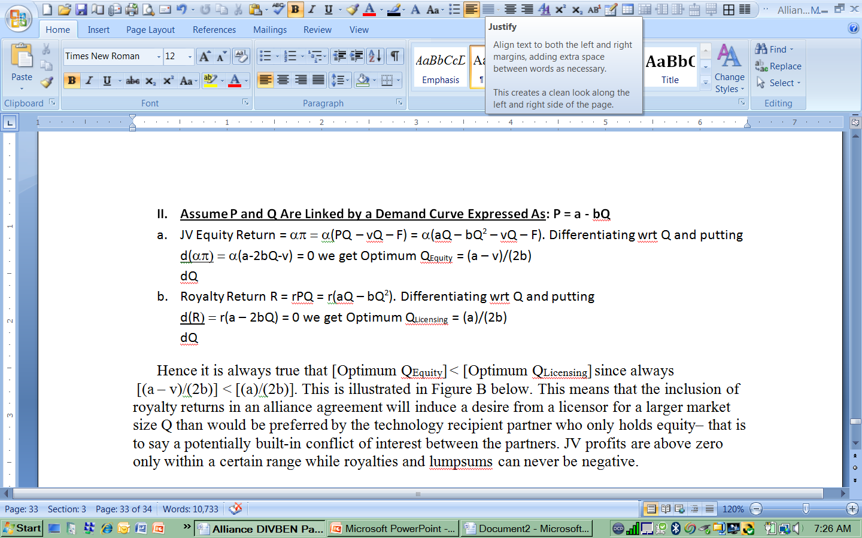
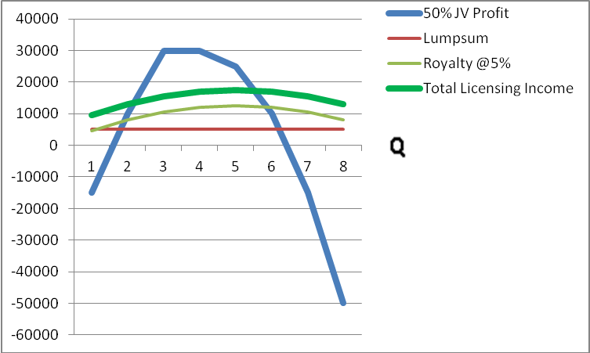
Comparing Volatility of JV Profits and Royalties
Under Different Optima for Partners (With P and Q linked)
Div
Roy
R
HR

